Slide 1
Duna Mozi
Készítette: Zoltán Czinege, Bálint Kristóf Fazekas

Slide 2
The purpose of the project
Simple and quick access to the cinema's offer
General information about movies
Simple and fast ticket reservation

Slide 3
Functions of the webpage
Average user functions:
Search among movies
Ticket booking
View Events and Film Screenings
Admin and employee functions
User Management (Only for Admin user)
Film, Film Screening and Event Management
Login

Slide 4
The Webpage
Frontend
Html
CSS
JavaScript
Bootstrap
Backend
NodeJS
REST API
Authentication
Database
MySql

Slide 5



Frontend
HTML
CSS
JavaScript
Bootstrap
Modules
Cypress

Slide 6
Backend
Modules
Bcryptjs
Cors
Dotenv
Email-validator
Express
Express-session
JSON Web Token
Mysql2
Nodemailer
Nodemon
NodeJS
REST API
Authentication
Jasonwebtoken
Roles

Slide 7
Database
MySQL
Model First
Loading Data
Admin and employee user
Movies
Movie categories
Tickets
Screening rooms
Procedures: 32
Tables: 10

Slide 8
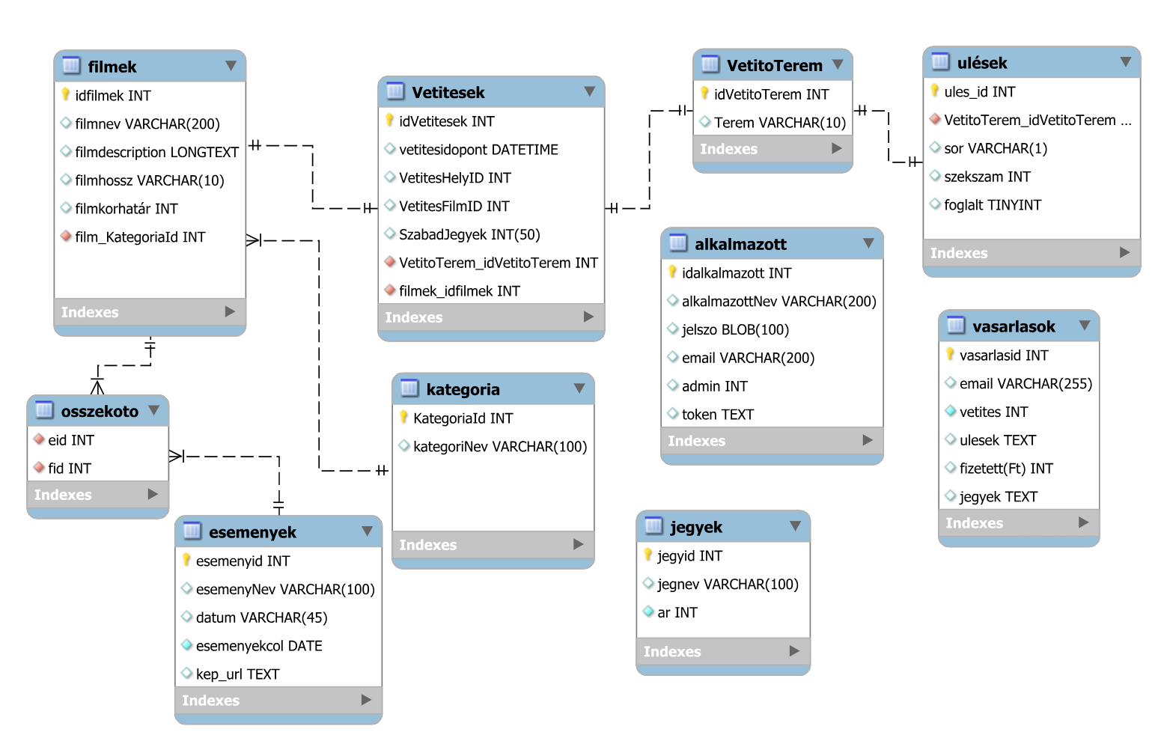

Slide 9
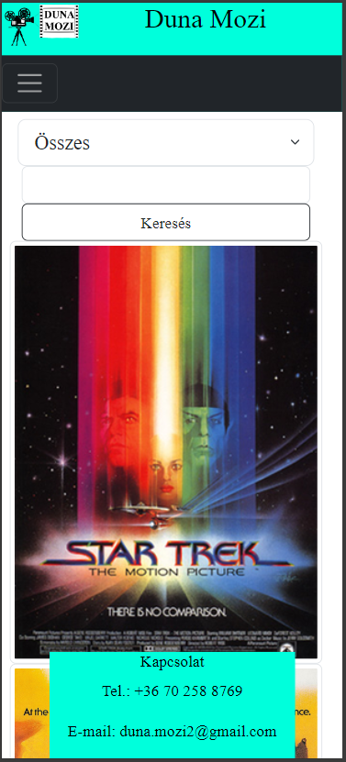
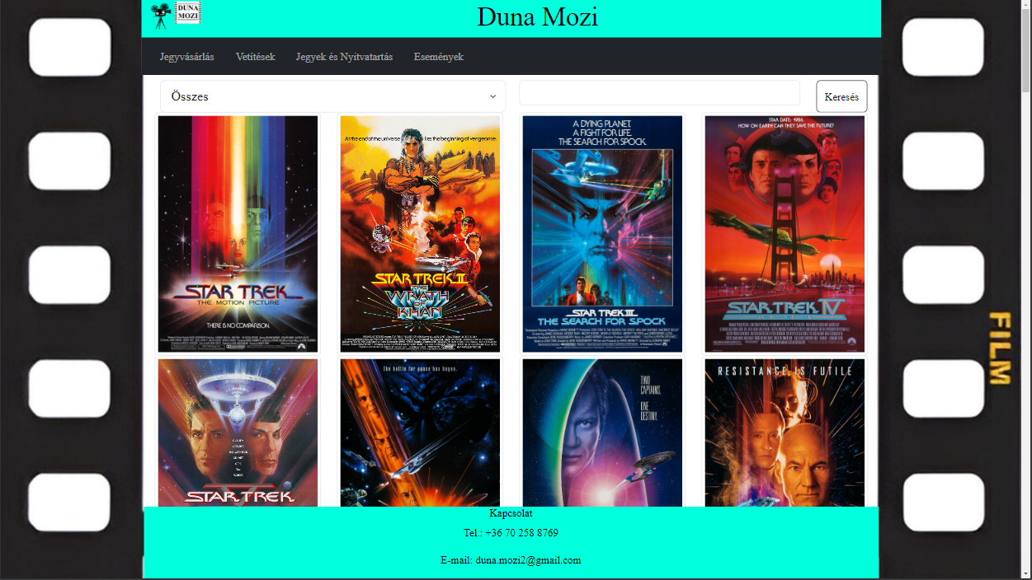
Responsivity
Available for mobile
Desktop
Mobile

Slide 10
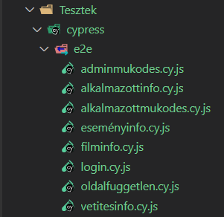
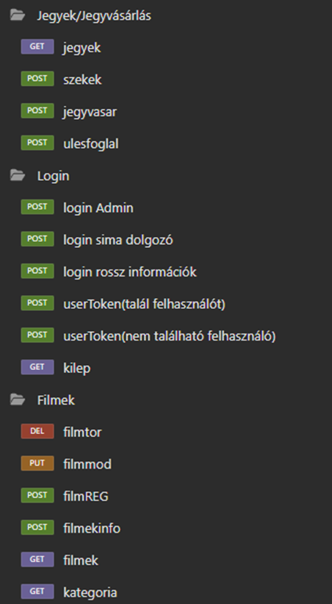
Tests
Frontend
Cypress
Test quantity: 80
Backend
Insomnia
Test quantity: 32

Slide 11
Teamwork
GitHub
Microsoft Teams
Client Software and Server Software developing
Progressing through smaller projects, not by files
Clean code

Slide 12
Work of Zoltán Czinege
Design
Bootstrep
Css
date format
Layout
Regex
Cypress tests
documentation

Slide 13
Work of Bálint Kristóf Fazekas (Backend)
Admin and employee functions
User, Film, Film Screening and Event Management
Login
Average user functions
Search movies by categories and movie titles
Tickets and Prices query
View future screenings and events
Ticket purchase
Upcoming screenings, and informations
Query the seating order of the screening rooms
Reservation of tickets and seats
sending an e-mail message upon successful booking

